Slide 1
User Research Summary
Prepared by the Digital Service at Veterans Affairs (DSVA)
Prepared for and presented to the VA Web Brand Consolidation Working Group
October 1, 2018

Slide 2
Outline
We gathered feedback from hundreds of Veterans about our plans for a new va.gov experience.
Study 1 – “Others” Resources Card Sort
Study 2 – Benefit Lifecycle Card Sort
Study 3 – Homepage Wireframe Tests
Study 4 – Navigation Tree Tests
Study 5 – Preview.va.gov Usability Test 1
Study 6 – Preview.va.gov Non-VA Vets
Study 7 – Preview.va.gov Usability Test 2
Study 8 – Preview.va.gov Authenticated Test

Slide 3
Study 8 – Preview.va.gov Authenticated Test

Slide 4
Our goal was to watch users with accounts work through preview top tasks
Study 8 – Preview.va.gov Authenticated Test
Remote user research on preview.va.gov authenticated experience
Recruited users with MHV, eBN, or ID.me accounts
Spoke with 9 Veterans of varying ages and races
Used the live preview.va.gov website
Task based: Gave users key tasks on va.gov which required login

Slide 5
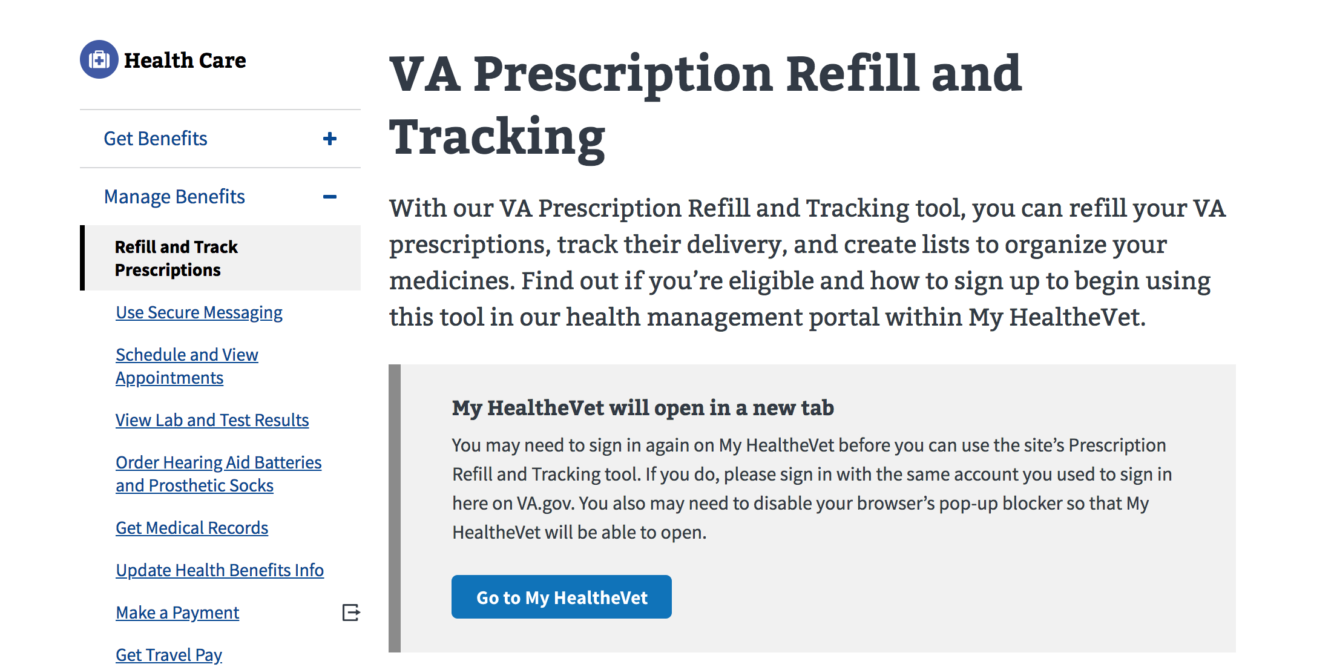
Veterans worked through several top tasks with their accounts
Study 8 – Preview.va.gov Authenticated Test
Refill Prescriptions
Secure Messaging
Check Vitals
Check Claim Status
Upload Evidence
Check Payment History

Slide 6
We confirmed key login tasks worked
Study 8 – Preview.va.gov Authenticated Test
Veterans were able to find the ”Sign In” box to login to their account
Users were able to complete MHV and eBN tasks from the VA.gov homepage
MHV and DS Logon users were able to see their dashboard and data on VA.gov
The ”My VA” and “My Health” tabs are working
Veterans easily located the drop-down with their name to log out and access settings

Slide 7
Veterans had mixed feedback about the login experience
Study 8 – Preview.va.gov Authenticated Test
“I like it’s actually going fairly quick. Usually when you have to connect your account, takes forever.” – P1
“Would be better if I didn’t have to click to open another tab. Better if it automatically opened in another tab.” - P1
“I would go to ebenefits. Of course I have to relog in, and I don’t like that. Wish it were directly connected.” – P2
“I wouldn’t want it every time (reauthentication 2FA) but I like that it’s quick.” - P2
“One concern I have is if a person isn't adept with both of these devices they might get ... if I have to do this every time?” – P3
“That is my account. I hope they're not making me change. It won't accept it. Doggone it. No, this is for VA.” – P8

Slide 8
We found several usability issues
Study 8 – Preview.va.gov Authenticated Test
Logging-out on VA.gov is not logging the user out of their MHV account
Veterans are generally not finding “My VA” and “My Health” in the top right of the page
Deep links into eBenefits are not useful, users attempting to upload documentation cannot complete task
Each new tab opening up eBenefits requires user to login again, credential is not being shared across tabs

Slide 9
Potential design solutions and discussions
Study 8 – Preview.va.gov Authenticated Test
Need to fix the few outstanding login bugs before launch
We may need to address the location/visual appeal of the “My VA” and ”My Health” tabs
Labels for Account Settings / Profile / My VA are not clearly differentiated for users
We need to work with the eBenefits team to make sure links to top tasks are usable from landing pages

Slide 10
What Now?
Study 8 – Preview.va.gov Authenticated Test
We are preparing the final changes prior to launch. All remaining issues are added to the backlog for post-launch prioritization.

Slide 11
Thank you!
Contact Jeff Barnes with questions:
jeffrey.barnes4@va.gov

